Slide 1
Upscaling Basic Sanitation for the Urban Poor (UBSUP)
Preparation of final design Technical Drawings Plan View

Slide 2
Content
Questions you might to ask yourself:
What is the context of this session?
How do potential DTF layouts looks like?
What has to be considered during layout preparation?

Slide 3
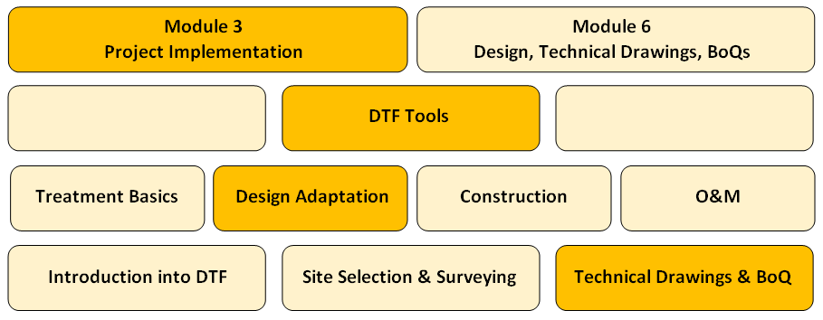
What is the context of this session?
The SafiSan Toolkit
This session

Slide 4
How do potential DTF layouts looks like?
VFCW
VFCW
SDRB
ABR
ST
CA
RB/BT
Storage

Slide 5
How do potential DTF layouts looks like?
VFCW
VFCW
SDRB
ABR
ST
CA
RB/BT
Storage

Slide 6
How do potential DTF layouts looks like?
VFCW
VFCW
ABR
ST
SDRB
RB/BT
CA
Storage

Slide 7
How do potential DTF layouts looks like?
VFCW
VFCW
ABR
CA
SDRB
ST
RB/BT
Storage

Slide 8
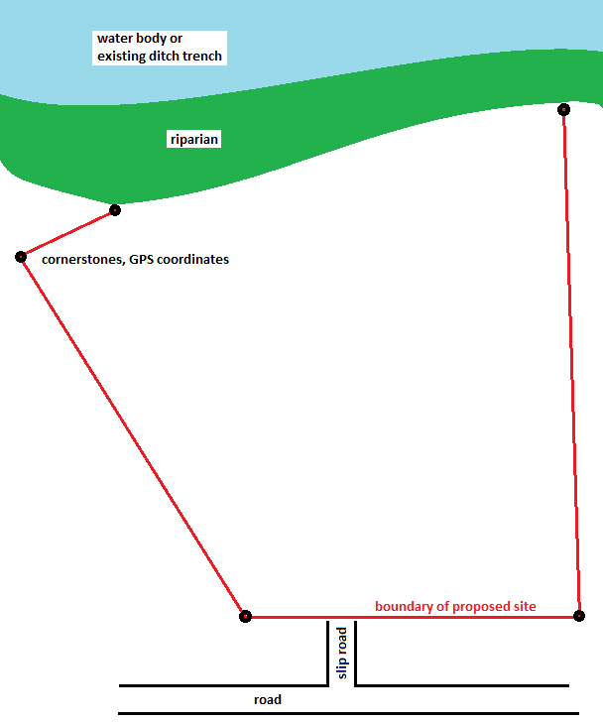
Baseline data collection - Boundaries
Mark corners (e.g. with metal rods)
Ensure sufficient distance (riparian) to water bodies as per NEMA

Slide 9
Design - Boundaries

Slide 10
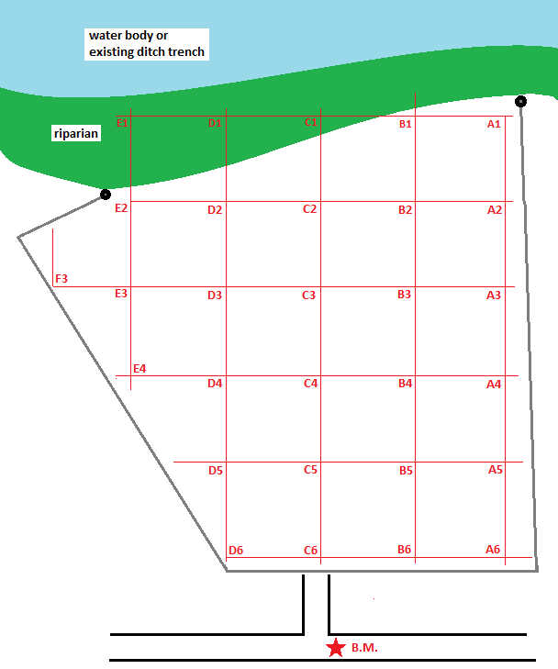
Baseline data collection - Raster levelling
Take levels according to a fix raster (20-30 points)
► To consider the existing ground level/ topography during the proper arrangement of the modules!

Slide 11
Design – Raster Levelling

Slide 12
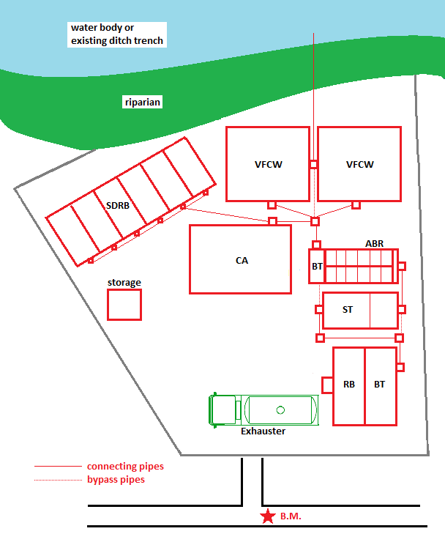
Baseline data collection - Arrangement
Arrange all required modules in an operational manner
Consider space for manoeuvring of exhauster trucks
Consider access for exhauster trucks to ST and ABR for de-sludging
Consider access to all treatment modules for O&M
Ensure proper arrangement of pipes, bypass pipes and inspection boxes
► To determine in the BoQs the number of inspection/bypass chambers!

Slide 13
Excursion: How are ST and ABR de-sludged?
To avoid a fixed pumping station (requires energy) exhauster trucks can be used to de-sludge the DTF modules
Exhausters pump sludge from bottom of ST and ABR (pump head approx. 3m)
Exhausters discharge sludge by gravity on top of SDRB (via hose)
► SDRB surface must be constructed slightly lower than discharge valve of exhauster truck
► SDRB outlet pipe must be constructed slightly higher than the inlet of the receiving treatment module (according to the DTF layout either the RB or ST or ABR or VFCW)
► To be considered in preparation of cross-section

Slide 14
Design - Arrangement
VFCW
VFCW
Operation
Regular Maintenance
Occasional Maintenance
ABR
CA
SDRB
ST
RB/BT
Storage

Slide 15
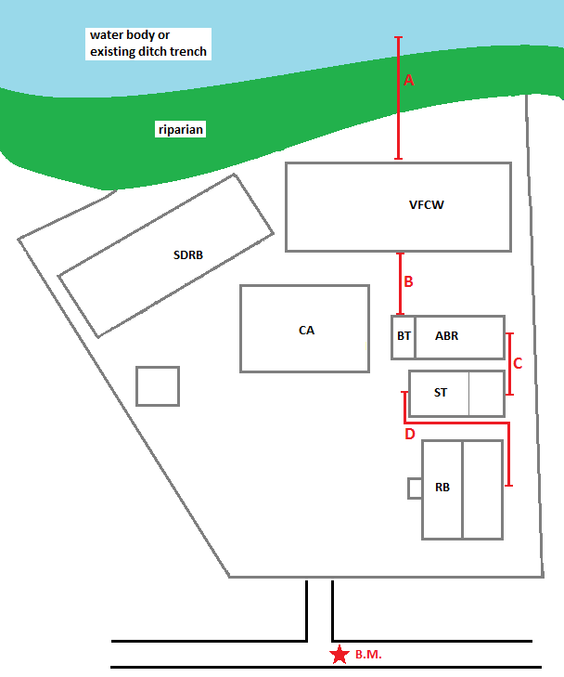
Baseline data collection - Distances
Determine distances:
VFCW outlet to final discharge point
Outlet of ABR-BT to VFCW
ST outlet to ABR inlet
Outlet of RB/BT to ST inlet
Drainage pipe from SDRB to ABR/VFCW
(Bypass pipes)
(Site boundaries)
► Required to determine in the BoQs the length of PVC pipes (connection & bypass)!

Slide 16
Design – Distances
A
VFCW
VFCW
Examples:
A: 40m
B: 7m
C: 9m
D: 4m
E: 4m
B
E
ABR
CA
C
SDRB
D
ST
RB/BT
Storage

Slide 17
Do you have any questions, remarks or suggestions?

